Slide 1

ANTI-MONEY-LAUNDERING

Slide 2
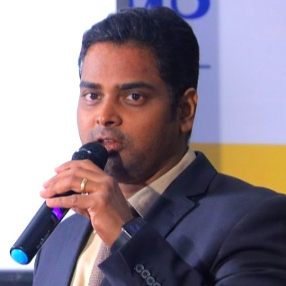
Project Leadership
Shiv Kumar Paswan
Project Guide/mentor at Innodatatics and Sponsor
linkedin.com
Apoorv Pathak
Project Guide/mentor at Innodatatics and Sponsor
linkedin.com
Bharani Kumar Depuru
Director at Innodatatics and Sponsor
linkedin.com

Slide 3
Team Members
Name: Sriram Iyer
https://www.linkedin.com/in/sriram-iyer-40898623b/

Slide 4

Contents
Understanding the Dataset
Attibutes Selection
Performing Data Preproccessing and EDA
Model Building
Deployment
Notes:
Change

Slide 5
Project Overview and Scope
The overall scope of the project is to detect money laundering transactions from the legit transaction and and to minimize human intervention in this process and maximize the detection of fraudulent transactions accurately and improve over time
Domain Knowledge is very much essential for this so proper research is to be done on money laundering and the variables associated with it to apply ML models on the same
Training and then deploying the Model using streamlit to see output of the model

Slide 6
Business Problem
Money Laundering is a very major issue that effects the very Economy of the country.It is highly difficult to detect actual transactions with fraud ones as patterns are highly complex and it takes a lot of time and resources for any one person or group of people to do the job manually..So the main Aim of the system is to maximize automate this process with the help of machine learning and minimize human intervention and efforts which will save a lot of time and money for the organization

Slide 7
Objective
Constraints
Minimize human intervention in detection of fraudulent transaction
Maximize the detection of fraudulent transactions accurately and keep improving over time
Multiple regualatory compliance (both state and central government) to be met since any wrong prediction can be fatal for the customer and the organization
For this model needs to very explainable so that any person in the back end can see the justification of the action
Data protection and privacy is very important constraint seeing as this is financial transaction data and data needs to be handled carefully so that no attackers gain access of it

Slide 8
CRISP-ML(Q) Methodology
Business & Data Understanding
Data Preparation
Modeling
Evaluation
Deployment
Monitoring and Maintenance

Slide 9
Technical Stacks
Anaconda Distribution to be Installed
Spyder or Jupyter Notebook with all standard python data science libraries (numpy,pandas,scikit-learn,seaborn,matplotlib) installed
Deployement Libraries
Streamlit

Slide 10
Project Architecture
Business Requirement ad Data Understanding
DATA PREPROCESSING AND EDA
MODEL BUILDING
DEPLOYMENT

Slide 11
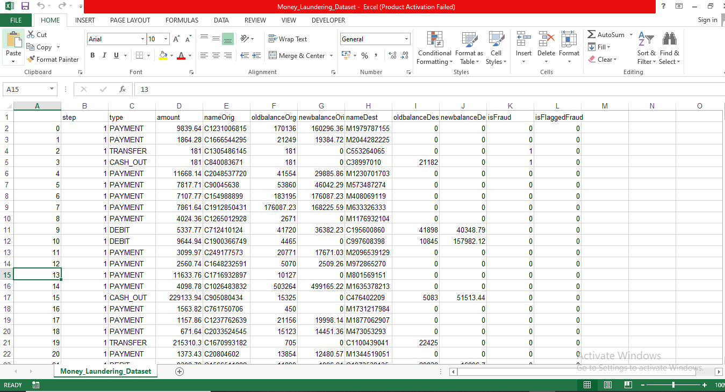
Data Snapshot

Slide 12
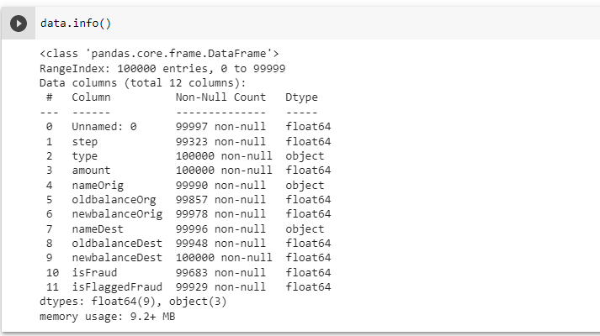
Data Information

Slide 13
Data Dictionary
step | maps a unit of time in the real world. In this case 1 step is 1 hour of time. Total steps 744 (30 days simulation).
type | CASH-IN, CASH-OUT, DEBIT, PAYMENT and TRANSFER.
amount | amount of the transaction in local currency.
nameOrig | customer who started the transaction
oldbalanceOrg | initial balance before the transaction.
newbalanceOrig | new balance after the transaction
nameDest | customer who is the recipient of the transaction
oldbalanceDest | initial balance recipient before the transaction. Note that there is not information for customers that start with M (Merchants).
newbalanceDest | new balance recipient after the transaction. Note that there is not information for customers that start with M (Merchants).
isFraud(Target variable) | This is the transactions made by the fraudulent agents inside the simulation. In this specific dataset the fraudulent behavior of the agents aims to profit by taking control or customers accounts and try to empty the funds by transferring to another account and then cashing out of the system.
isFlaggedFraud | The business model aims to control massive transfers from one account to another and flags illegal attempts. An illegal attempt in this dataset is an attempt to transfer more than 200.000 in a single transaction.

Slide 14
System Requirements
Anaconda Distribution to be Installed
Spyder/Jupyter Notebook with all standard python libraries (numpy,pandas,scikit-learn,seaborn,matplotlib)
Deployement Libraries
Flask
My System Specification –
8 GB RAM, 2 GB Nvidia GeForce Graphics Card,Intel core i5 Processor(7th Gen)
Windows 7 Professional

Slide 15
Exploratory Data Analysis [EDA]
Understanding the Variables and their types in Dataset
Data Cleaning
Using EDA with the help of metrics and graph to give us insight on skewness ,outliers etc and how to deal with them
Notes:
EDA is used for seeing what the data can tell us before the modeling task.
Change

Slide 16
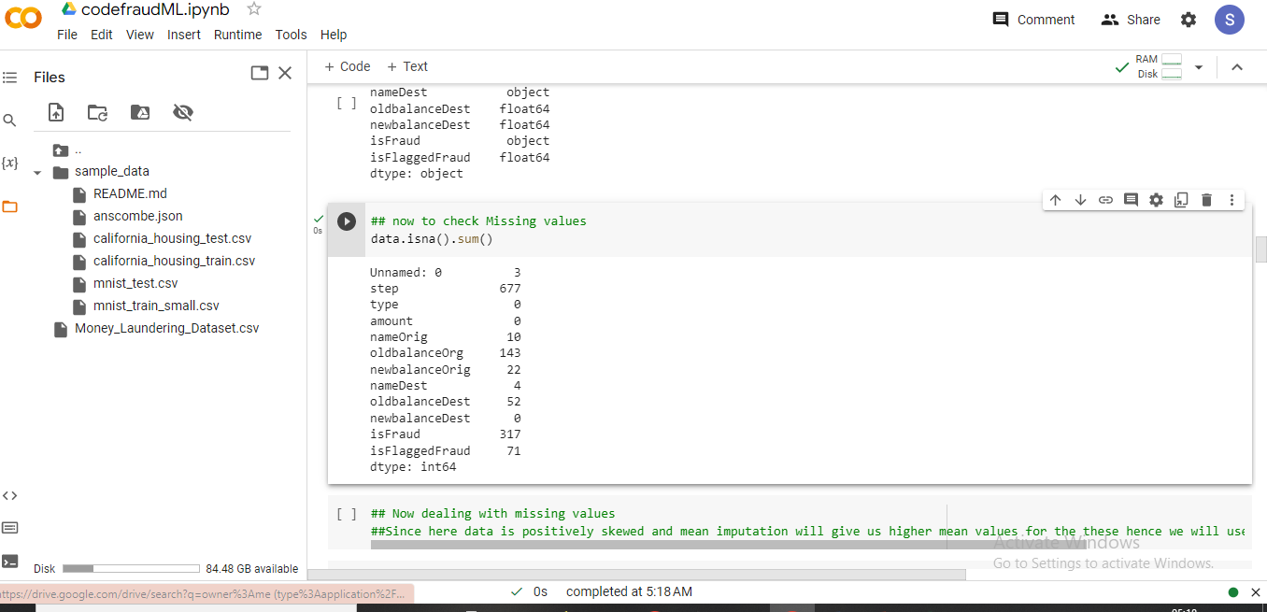
Missing Values Observation

Slide 17
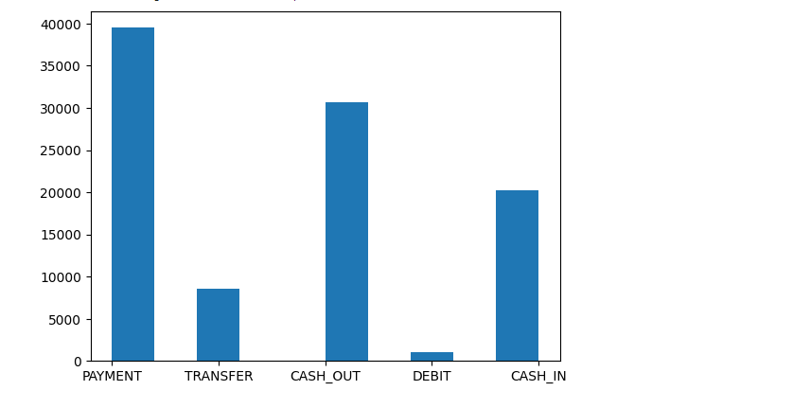
Data Visualization
Notes:
Keep observations

Slide 18
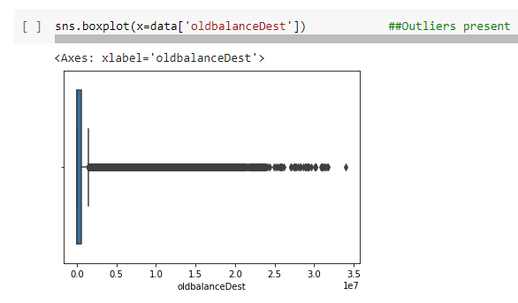
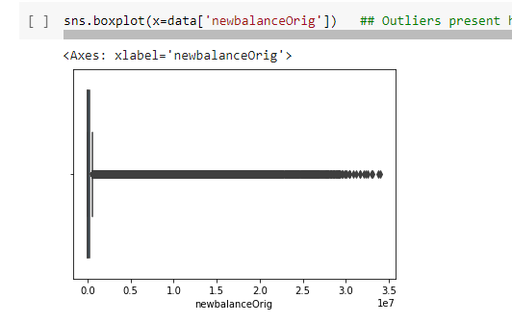
Data Visualization
Notes:
Add graphical

Slide 19
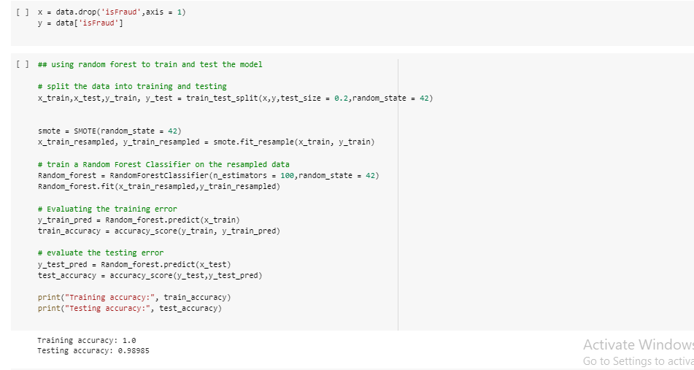
Model Building
Notes:
classification is the task of predicting a discrete class label. Regression is the task of predicting a continuous quantity.
What is classification techniques in machine learning?
The Classification algorithm is a Supervised Learning technique that is used to identify the category of new observations on the basis of training data. In Classification, a program learns from the given dataset or observations and then classifies new observation into several classes or groups.
What is regression techniques in machine learning?
Regression is a technique for investigating the relationship between independent variables or features and a dependent variable or outcome. It's used as a method for predictive modeling in machine learning, in which an algorithm is used to predict continuous outcomes.

Slide 20
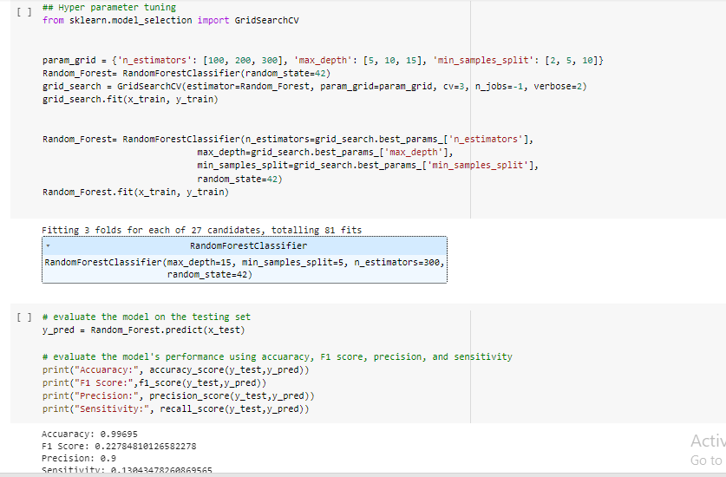
Model Building –(After Hyper Parameter Tuning)
Notes:
What is the role of regression in ML
Is regression supervised or unsupervised?

Slide 21
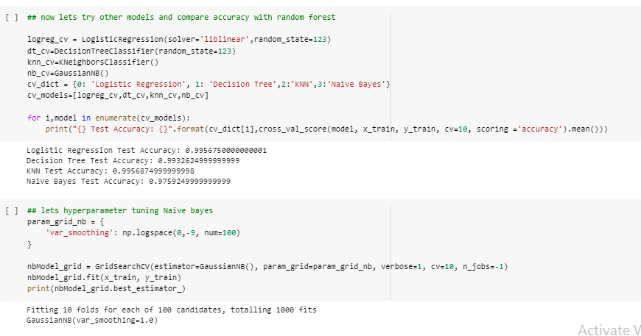
Model Building –(Multiple Models Accuracy)

Slide 22
Model Accuracy Comparison
Naïve Bayes – Accuracy 97%
Linear regression – 98.56%
Decision Tree – 99.22 %
KNN- 99.56 %
Random Forest – 99.69%(Best Model)

Slide 23
Model Deployment – Strategy(Using Streamlit)
Model deployment was done with streamlit
We used pickle to save our finalised model
Then we create a app.py file to integrade our saved model to streamlit libraries with html tags to get input from user to run it on the model
After we get the result from our model through the streamlit run

Slide 24
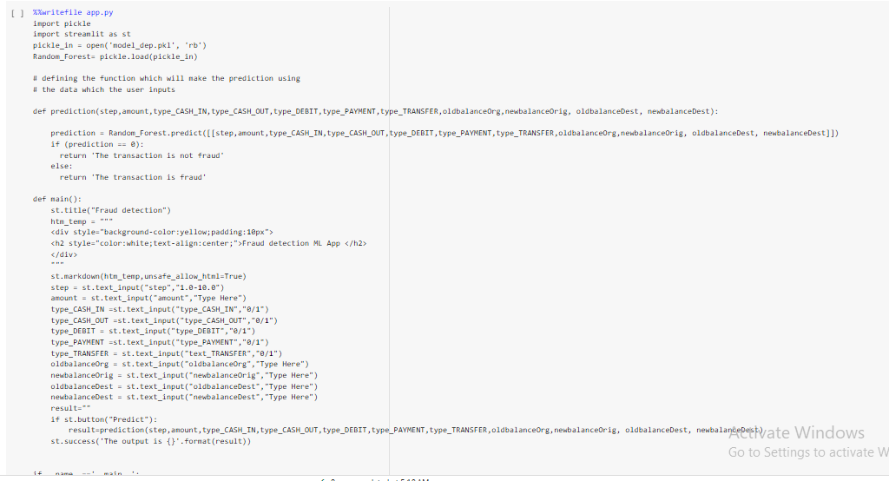
Screen shot of output

Slide 25
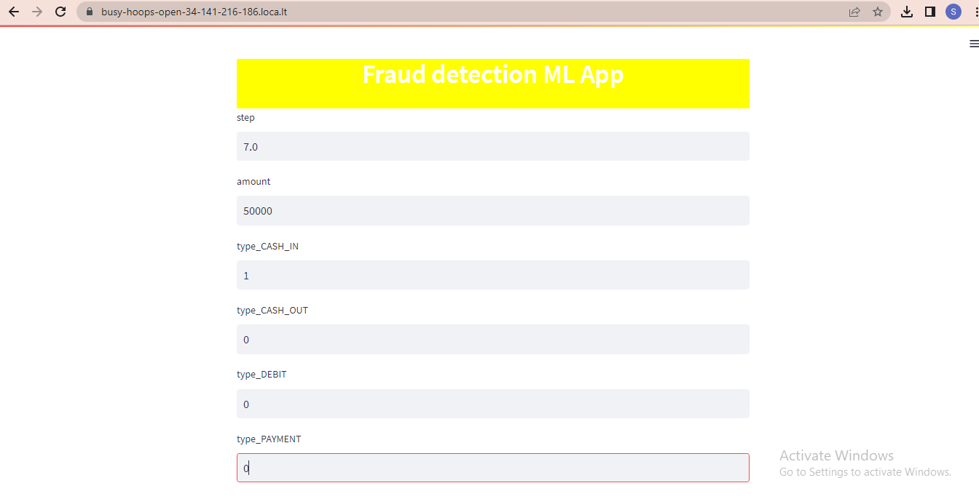
Screen shot of output

Slide 26
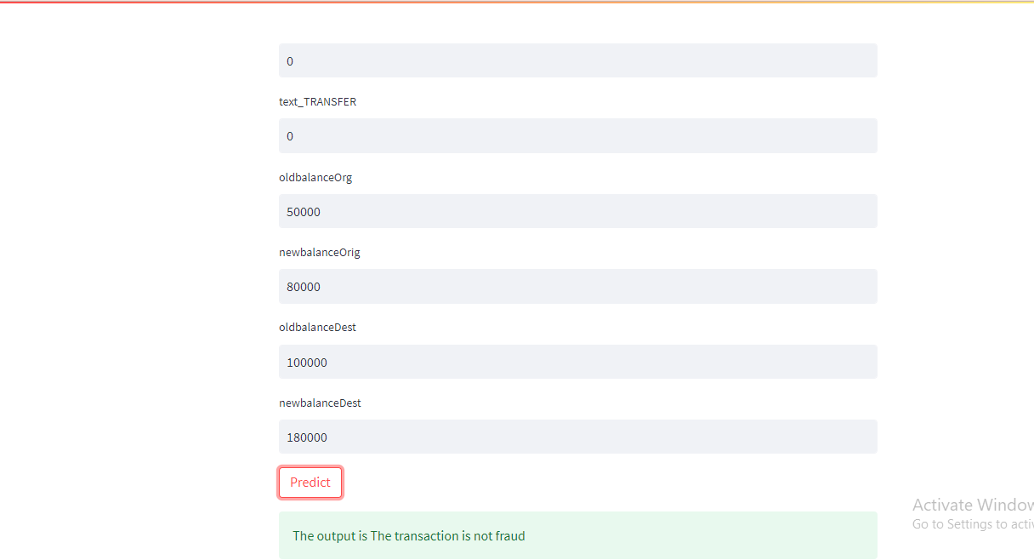
Screen shot of output

Slide 27
Challenges
There were some challenges throughout the tenure of the project such as
Transaction Data was highly unbalanced with many Outliers in the dataset
Since the data also had considerable missing values dealing with them was a bit tricky since in this dataset as it deals with transaction data with high skewness
Even after model building the deployment part had its issues since streamlit framework is very specific on the type of data passed from the deployment perspective on model so the errors had to be rectified accordingly

Slide 28
Future Scopes
ML will most definitely will redefine the way the near future in banking domain with automation so as the there is very less load on humans to identify and flag transactions
Also ML makes the operation very fast in the matter of minutes what takes domain analysts months and years to find
ML models are easy to deploy in any systems and they can adapt to the scale of data quiet easily which is very important aspect for banking since number of transaction in a minute is very high and we need accurate predictions in very less time.

Slide 29

Queries ?

Slide 30


